Slide 1

Customer Shopping Behavior Analysis
Uncovering insights from 3,900 purchases to guide strategic business decisions

Slide 2

PROJECT OVERVIEW
Understanding Customer Behavior
Dataset Scale
Key Focus Areas
Strategic Goal
3,900 transactions analyzed across multiple product categories
Spending patterns, customer segments, product preferences, subscriptions
Drive data-informed business decisions and growth

Slide 3
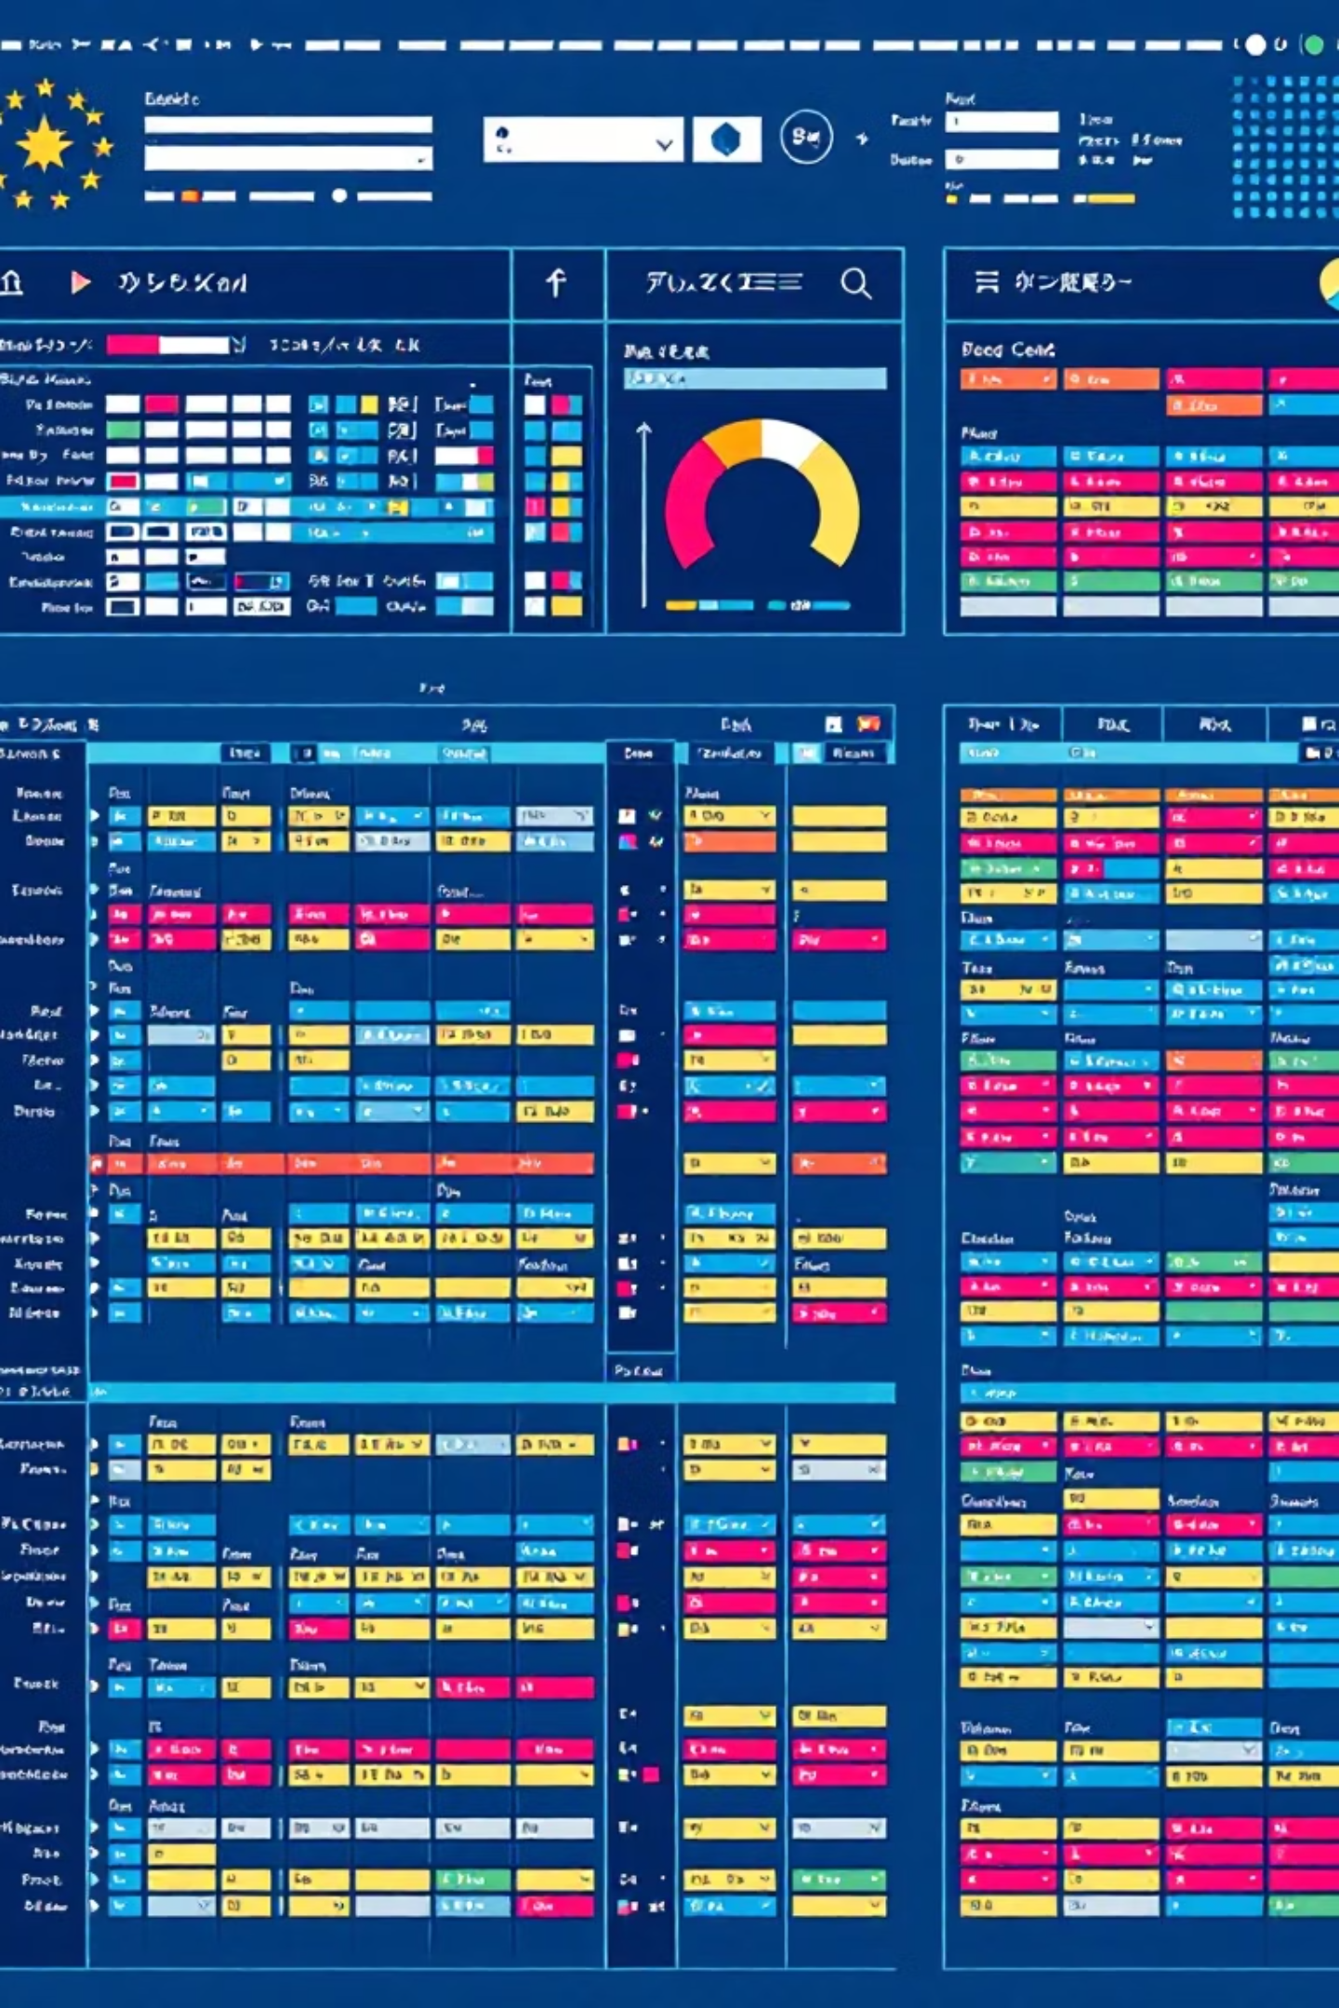
Dataset at a Glance
Core Features
Customer demographics (Age, Gender, Location)
Purchase details (Item, Category, Amount, Season)
Shopping behavior (Discounts, Reviews, Shipping)
Subscription status tracking
3.9K
18
37
Total Rows
Data Columns
Missing Values
In Review Rating only

Slide 4
PYTHON ANALYSIS
Data Preparation & Cleaning
01
02
Data Loading & Exploration
Missing Data Handling
Imported dataset, checked structure with df.info() and summary statistics
Imputed Review Rating nulls using median rating per product category
03
04
Feature Engineering
Database Integration
Created age_group bins and purchase_frequency_days columns
Connected to PostgreSQL and loaded cleaned data for SQL analysis

Slide 5
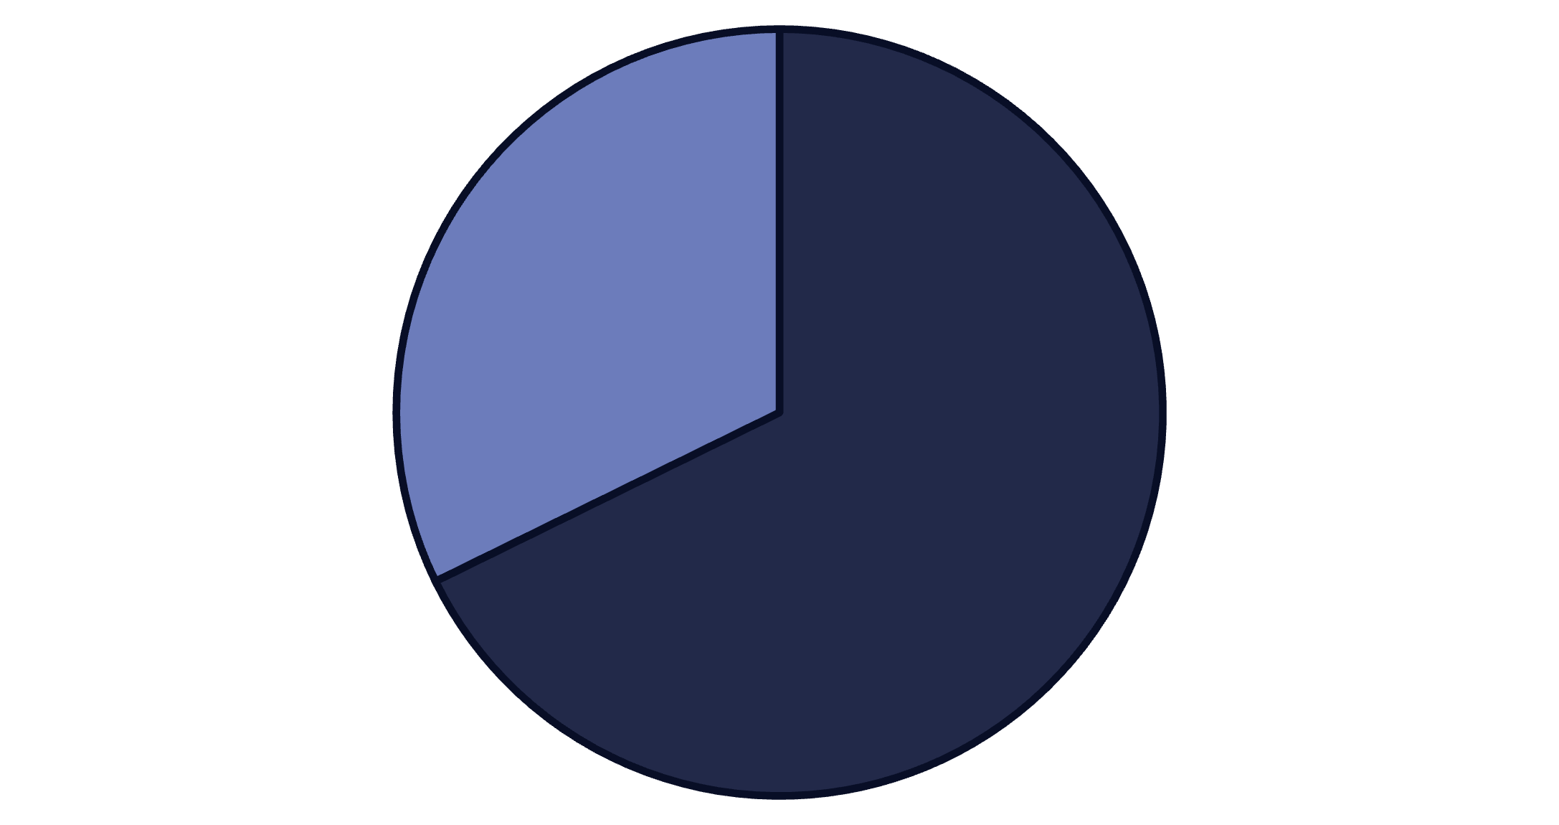
SQL INSIGHTS
Revenue & Customer Patterns
Gender Revenue Split
Male customers generate 68% of total revenue, more than double female customer spend
High-Value Discount Users
839 customers used discounts but still spent above average ($60), showing smart shoppers who aren't price-sensitive
Male
Female

Slide 6
Top-Rated Products & Shipping Insights
Highest-Rated Items
77%
77%
Gloves
Sandals
3.86 rating
3.84 rating
76%
76%
Boots
Hat
3.82 rating
3.80 rating
Express shipping customers spend $2 more on average ($60.48 vs $58.46 standard)

Slide 7


Subscription Analysis
Subscribers
1,053 customers
Average spend: $59.49
Total revenue: $62,645
Non-Subscribers
2,847 customers
Average spend: $59.87
Total revenue: $170,436
Only 27% subscribe, but spending is nearly identical—huge opportunity to convert non-subscribers

Slide 8

Customer Segmentation & Product Performance
Returning — 701
Loyal — 3,116
Discount-Dependent Products
Top 5 items with highest discount rates:
Hat (50%)
Sneakers (49.66%)
Coat (49.07%)
Sweater (48.17%)
Pants (47.37%)
New — 83
80% of customers are loyal repeat buyers—retention is strong

Slide 9
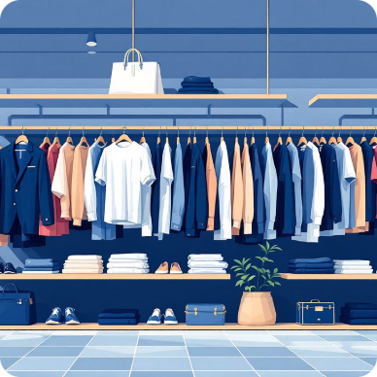


POWER BI DASHBOARD
Visual Insights Overview
Category Leaders
Age Group Performance
Quality Metrics
Clothing dominates with $100K revenue and 1,800 sales
Average 3.75 review rating across all products
Young Adults lead revenue at $50K and 1,200 sales

Slide 10
ACTION PLAN
Strategic Recommendations
Boost Subscriptions
1
Promote exclusive benefits—only 27% subscribe despite similar spending
Loyalty Programs
2
Reward repeat buyers to strengthen the 80% loyal customer base
Review Discount Policy
3
Balance promotions with margins—some products 50% discounted
Product Positioning
4
Highlight top-rated items (Gloves, Sandals, Boots) in campaigns
Targeted Marketing
5
Focus on Young Adults and express-shipping users for highest ROI

